Slide 1

REX-FIT
Team- Mind's Eye
Team Members-
Vandana Mall
Yash Shukla

Slide 2
1
The Problem Rex-Fit Solves
2
Features
Contents
3
Advantages
4
Buisness Prospects

Slide 3
1
The Problem Rex-Fit Solves
Good health is not something we can buy. However, it can be an extremely valuable savings account, and REX-FIT is a step for opening that saving account.
It will keep a record of your steps, calories, water intake, will help to find the proper diet to lose weight, will have a reminder for medicine intake, will have yoga sessions that keep you fit, and for an emergency will show nearby clinic or hospitals.

Slide 4
2
Features
Step & Calories Counter
Nearby Clincs/ Hospitals
Hydration Reminder
Diet Blog
Medicine Reminder
Yoga Session
Daily Exercise Routine
Personalized Diet Plan

Slide 5




Step & Calorie Counter
These features will keep track of your steps and calories and will display the day, the weekly and monthly graph for the track, and also set daily targets.
Yoga Session
This feature will provide daily yoga sessions with the timer set for each yoga with the picture of the pose.
Hydration Reminder
This feature will remind the user to drink water and keep track of daily water intake and will set daily targets according to the weight of a person.
Diet Blog
This feature will help the user to have a piece of proper knowledge about how to maintain a healthy diet plan.

Slide 6



Medicine Reminder
This feature will remind the user to take their medicine on time.
Nearby Hospitals/ Clinics
This feature will display all the hospitals or clinics nearby and in an emergency will make a call in hospitals.
Daily Exercise Routine
This will be connected with a trainer or a gym and will have online workout sessions on a daily basis according to the user requirement and will act just like a personal trainer.
Personalized Diet Plan
In this feature, the user will have to fill a question-answer form, and then it will proceed to a dietician for making a proper diet plan.

Slide 7
Advantages
Gives patients faster access to providers and care
Power to monitor your health
Low risk to miss intake of medecines or water
Cost-Effective & Encourage a healthy lifestyle

Slide 8
Buisness Prospective
According to research the healthcare sector will become one of the top revenue contributors and it is estimated to reach a figure of $372 billion in 2022 from $140 billion in 2016
Another survey from Accenture Consultants point out that the download in the number of healthcare app has doubled in the past couple of years
According to a stat, 93% of the doctors believe that healthcare apps can bring improvement in patient’s health and 80% of the physicians are using the mobile technology to deliver the patient care.
Another research says if health apps were used across all diseases, that the healthcare system could potentially save $46 billion in annual cost

Slide 9
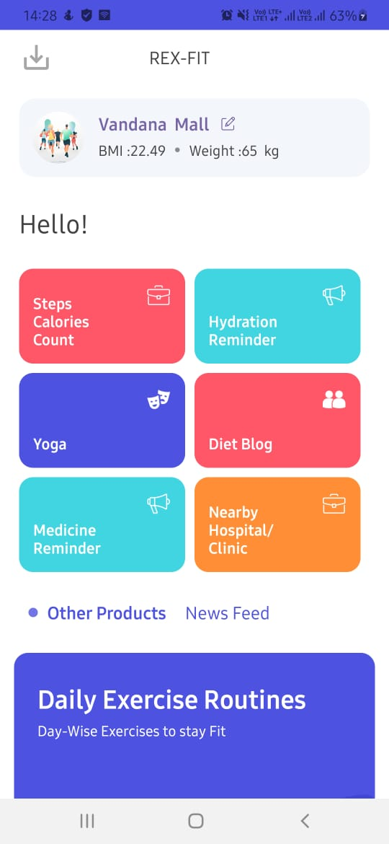
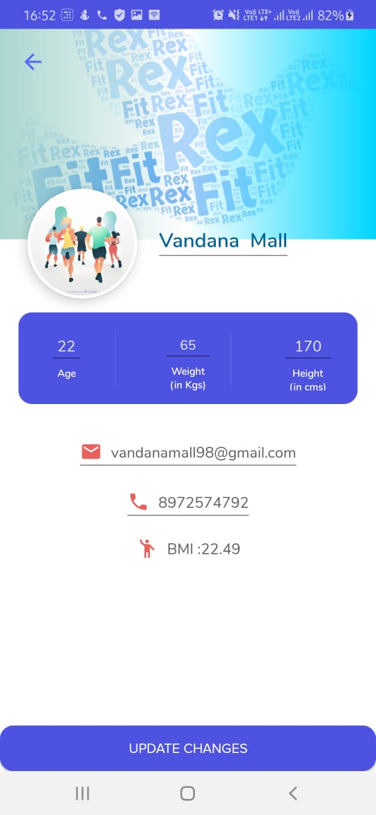
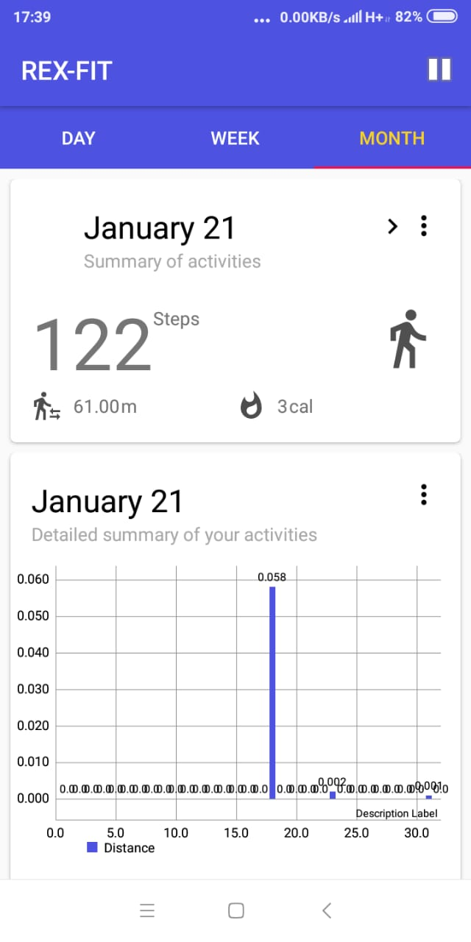
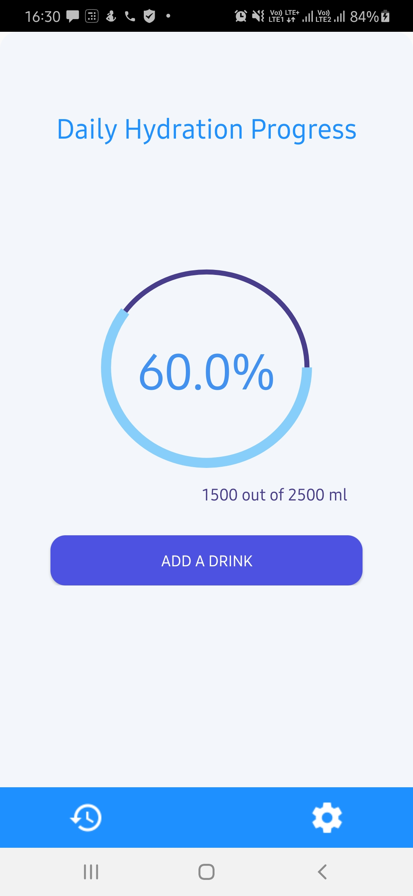


Application Screenshots

Slide 10
Thank you!

